Slide 1
Introduction to Locating Systems for Buried Utilities

Slide 2
LOCATING BURIED UTILITIES
Many buried utility systems have an estimated 80 year life span, but a locatable life that ranges from 0-30 years. Getting more locatable years out of an effective system involves proper construction, testing, and maintenance.
The reduction of accidental dig-ins to buried utilities is the goal of every utility company. The goal of this presentation is to provide you with detailed information about the most common locating system and allow you to make better engineering decisions.

Slide 3
WHAT IS THE MOST COMMON LOCATING METHODS
TODAY FOR BURIED UTILITIES?
Tracer Wire
Tracer wire provides one purpose, to locate buried utilities through means of conductive locating. While this is considered the tried and true way of conductively locating buried utilities, it does not provide a visual “stop-sign”
effect rendering it useless if utility hasn’t been located or properly marked.
Detectable & Non-Detectable Marking Tape
The purpose of both marking tapes is to provide a visual “stop-sign” effect
well before the contractor comes into contact with the buried utility. The tape
identifies what type of utility is beneath him. Utilizing a detectable tape
gives you the option to inductively locate the aluminum foil within the tape
with a non-ferrous metal locator.

Slide 4
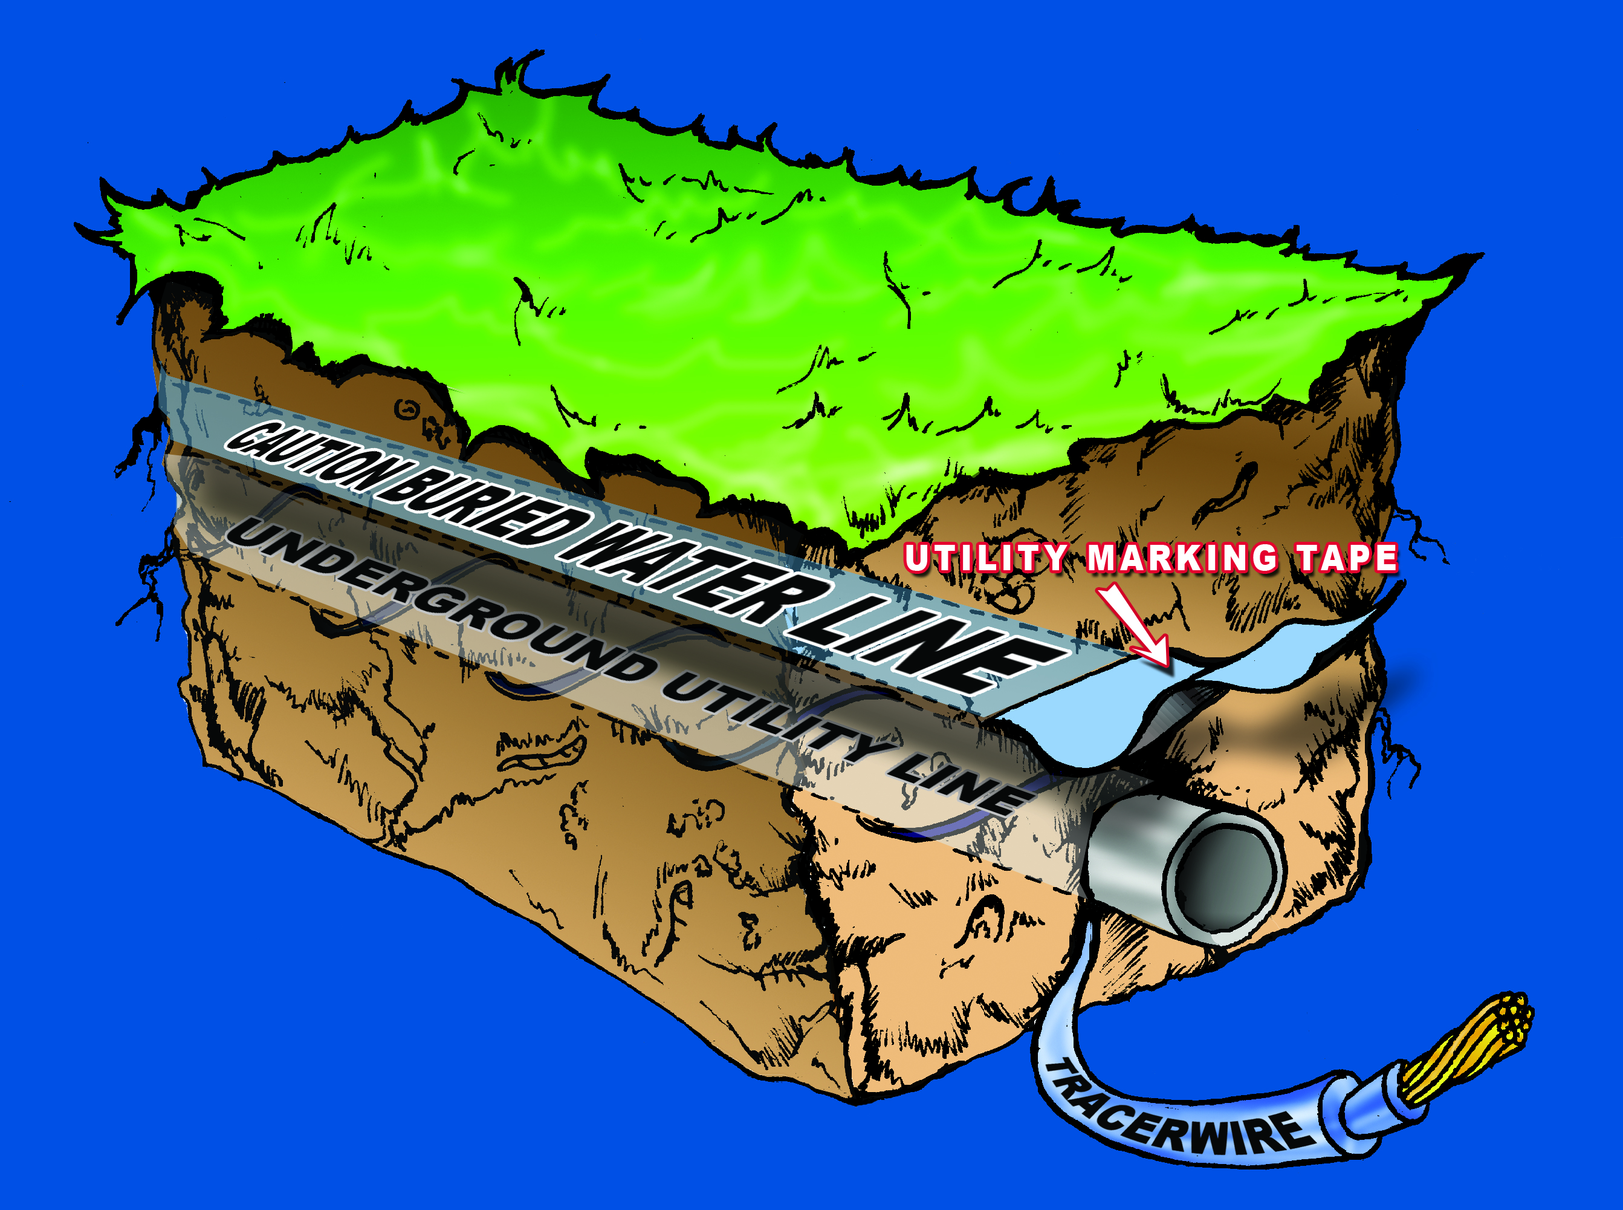
COMPONETS OF AN EFFECTIVE LOCATING SYSTEM
FEATURES / BENEFITS
First shovel full out provides
“Stop-Sign” visual
Marking tape is designed to
last for the life of the utility
Identify type of buried utility
Tracer wire gives precise path
of utility with conductive
locate.
It can save lives and helps
prevent costly “dig-ins”
RECOMMENDED BURIAL DEPTHS FOR MARKING TAPE
2” Marking Tape = 6 to 9 inches below ground surface
3” Marking Tape = 9 to 12 inches below ground surface
6” Marking Tape = 12 to 18 inches below ground surface
12” Marking Tape = 24 to 30 inches below ground surface

Slide 5
TRACER WIRE HISTORY
The use of un-insulated tracer wire dates back to early 1900’s. First documentation shows tracer wire being used in buried gas line so they would be able to locate for various reasons. Water, sewer, and other utilities followed suit.
The utility industry soon learned that the use of un-insulated tracer wire created corrosion issues over time due to the various soil conditions such as moisture, salt, and other elements. When the tracer wire finally broke, the path of conductivity was lost rendering the wire useless. It is also important to note that the earth acts as a ground greatly reducing the traceability of the wire if no insulation is present.
Over the years, the process of insulating (or jacketing) alleviated or prolonged the life of the tracer wire making it very reliable for locating buried utilities. THHN tracer wire, consisting of a PVC/Nylon insulation was a popular choice because it was the first mass produced insulated wire of its time and readily available. At this point in time, there was no direct burial rating in affect by Underwriters Laboratory (UL).
Today, UL has standards in place that require all buried cables to have a direct burial rating if used in power applications. Tracer wire doesn’t fall under this category, but is under review and will apply to tracer wire eventually. THHN should not be used.

Slide 7
QUESTIONS & ANSWERS ABOUT COPPER-CLAD STEEL (CCS)
What is Copper-Clad Steel (CCS) wire and how is it made?
Copper-Clad Steel (CCS) is a bimetal conductor that utilizes a low or high carbon steel
core, metallurgically bonded with a copper cladding, that is uniform and continuous.
The process of manufacturing starts off utilizing a steel rod and two copper strips, bonded
together by heat and pressure. The result is CCS in rod form. The CCS rod is then drawn to
an intermediate size and heat treated. The intermediate size is drawn down again to its
final size. An additional heat treating process is added for annealed material. Heat and
pressure, along with the drawing process, ensures uniform and continuous copper
thicknesses throughout the wire. The metallurgical bond of both metals make CCS
perform as one metal.

Slide 8
QUESTIONS & ANSWERS ABOUT COPPER-CLAD STEEL (CCS)
2. What is the difference between HF-CCS and HDD-CCS tracer wires?
HF-CCS (High-Flex Copper-Clad Steel)
Designed specifically for open-trench installations. This product undergoes a special
annealing process that is unique. This product is designed to embody the flexibility,
memory, and feel of copper wire, but is 43% higher in break-strength. There is minimal
spring release (recoil) on the reels making it very user friendly. This product cost less than
copper wire, and is considered equal in signal strength. A technologically advanced
annealing process on the HF-CCS giving it the unique traits of flexibility and strength.
HDD-CCS (Horizontal Directional Drilling Copper-Clad Steel)
Designed specifically for directional drilling (boring) installations. This product utilizes a
special high-carbon steel core that is unique to HDD-CCS. This product is designed with
700% higher breaking-strength than copper wire. Only 1 wire is needed and prevents
breaks or re-bores in directional drilling installations. With copper, multiple wires are
needed to prevent breaks and is extremely expensive. This product cost less than using
copper, and provides equal locating performance. In simple terms, HDD-CCS provides the
same break-load as 6 copper wires.

